Slide 1

Local Self Govt. Jaipur
Smart Food Vans Of Annapurna Rasoi Yojna Project
Photo courtesy of Dr. Nickie Cauthen

Slide 2
Trust :- Jeevan Sambal Charitable Trust, Kota
Presentation by: - Abhishek kumar Lodhi

Slide 3
Project’s Purpose
The Government of Rajasthan started Annapurna Kitchen Scheme on December 15, 2016. Under this scheme, all citizens in the state will get breakfast in the morning, lunch in the afternoon and dinner at night.
The Government of Rajasthan has started Annapurna Kitchen Scheme for the sake of their health by keeping workers, rickshaw-pullers, handlers, employees, students, working women, elderly and other helpless, needy persons in the urban areas of the state.
The purpose of this scheme is not to give food for free in a manner, to feed all the helpless and needy persons so that they do not starve during the night

Slide 4
First Year Journey
This scheme was inaugurated on December 15, 2016.
In 12 districts of the state, 80 Annapurna Kitchen Van under this scheme is being provided with breakfast in just Rs 5 and nutritious food in only Rs 8.
When this scheme completed a one year it collected 50,80,493 beneficiary by 80 food vans of 12 cities.
It was successful scheme of Rajashan Govt. which is operated by DLB (Director of local body ) Jaipur.
Jeevan Sambal Charitable Trust (JSCT) is working to complete this project on DLB direction .

Slide 5
Implementation Areas
Promotion:- This scheme developed for all the helpless and needy persons so Govt. promote this scheme in all urban cities by banners and posters. In the I.T. sector we made a website for better information of Annapurna Rasoi Yojna where contains all data of this project and url is http://annapurana.urban.rajasthan.gov.in
Increase Food Menu:- To make more successful this Annapurna Rasoi govt needs to increase food menu and improve food quality. Then customer traffic will increase on this project.
IT Development:- GPS system developed on food vans and tracking available on RAAS (Govt Site)portal. Beneficiary report update on Govt. server by smart food vans POS machine.

Slide 6
Customer Care:- Customer care service available on toll free no. 18001231063 from 10 am to 5 pm. They take feedback and complains and resolve complain on same time.
Control Room :- Control room manage of those person who are in vans for food distribution that they are following rules or not like they are wearing annapurna dress, apron and its hygienic or unhygienic etc.
Pos Machine Development :- Beneficiary report depends on POS Machine data so it connected with annapurna website of DOIT server. After fetching device with annapurna portal then beneficiary report regularly update with new tokens .
Vans live Monitoring :- DLB live monitoring with beneficiaries and take feedback about food, van, hygienic and suggestion.

Slide 7
Second Year Journey
After one year successful journey it has made record in rajasthan.
Then second year it came with 500 vans to cover 191 ulb till april 2018 proposal .
To achieve this target trust make 20 kitchen center in 20 different city.
400000 beneficiary /day achieving from 500 smart food vans in 191 ULB.

Slide 8
Current Status
We covered 191 ULB with 495 smart food vans in Rajasthan.
Around 3 lak beneficiary/day comes on smart food vans.
Total Beneficiary 18,66,38,752 from 15 dec 2016 to present.
DLB tracking smart food vans by GPS system which is available on RAAS portal.
DLB take live feedback from customer of food.
Trust’s control room are monitoring 24x7 hours.
Photo courtesy of Dr. Nickie Cauthen

Slide 9
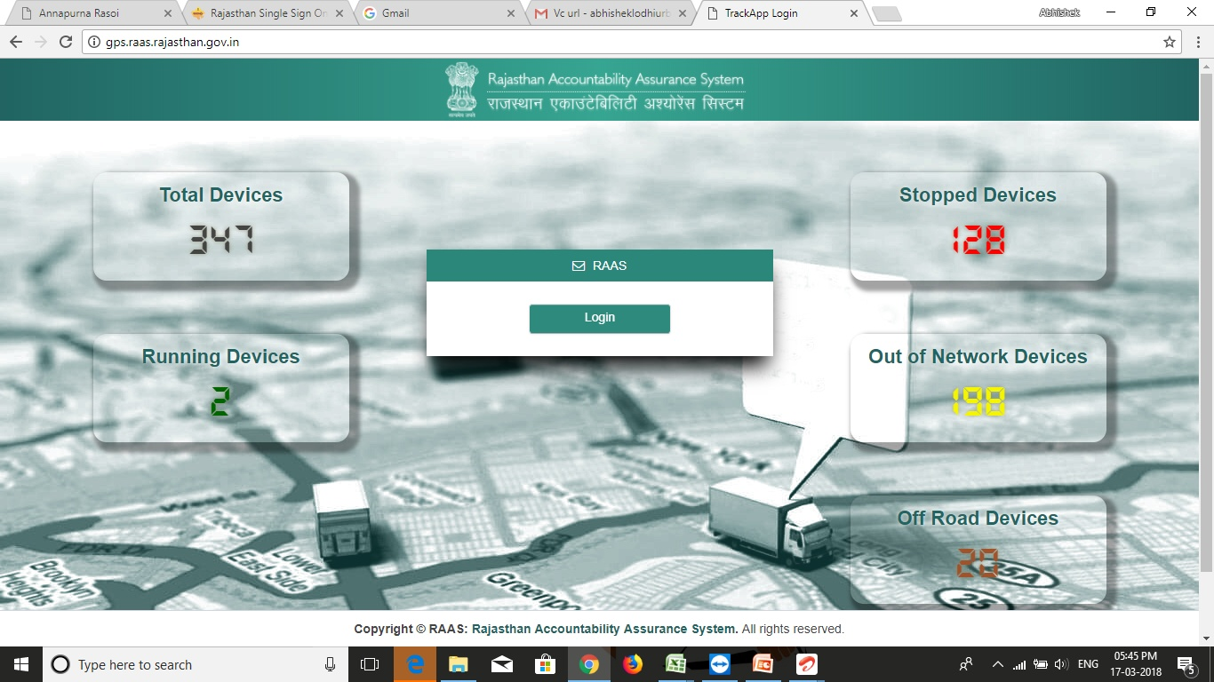
Plasmodium Life Cycle
http://www.who.int/tdr/diseases/malaria/lifecycle.htm
Notes:
Annapurna Rasoi Project Video

Slide 10
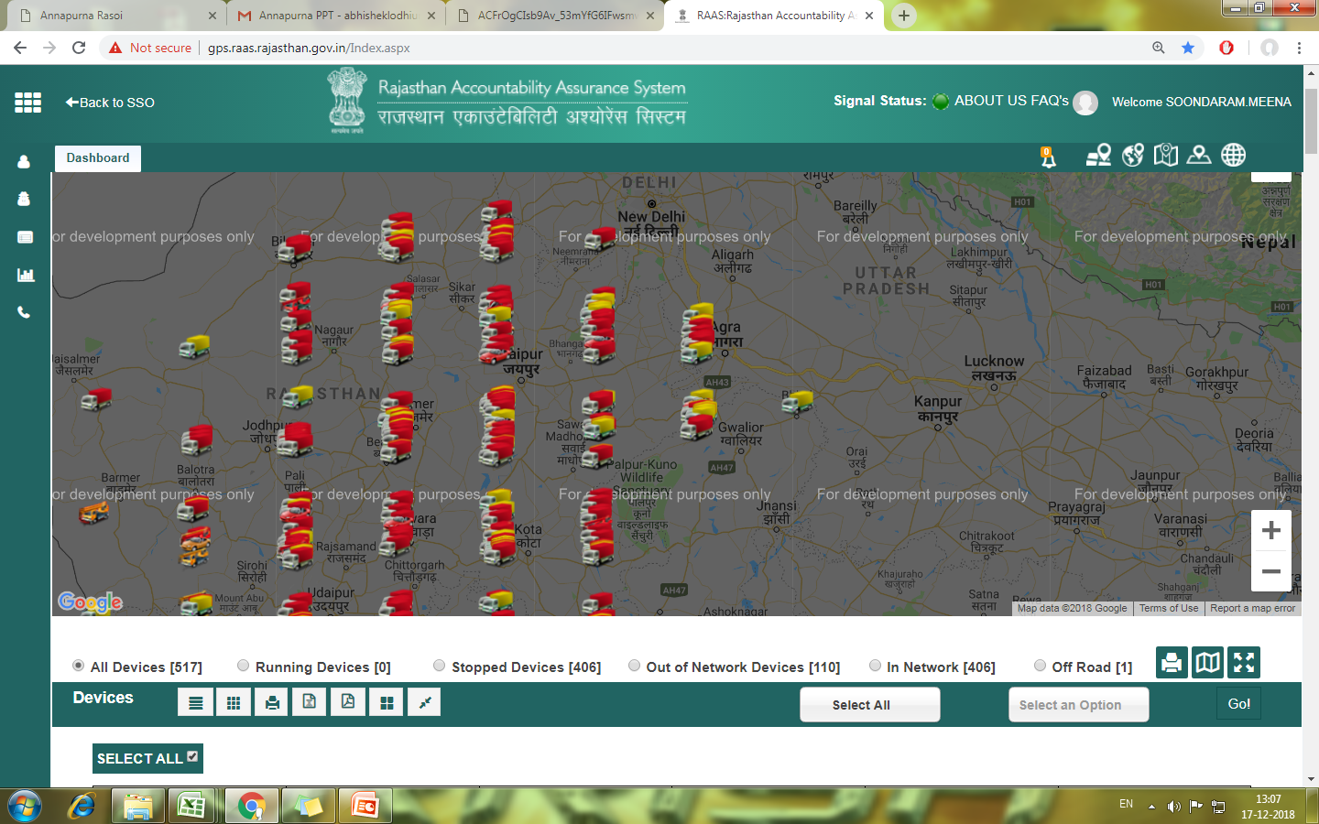
Live GPS Tracking Poral
http://www.who.int/tdr/diseases/malaria/lifecycle.htm
Notes:
Live GPS Tracking Portal

Slide 11
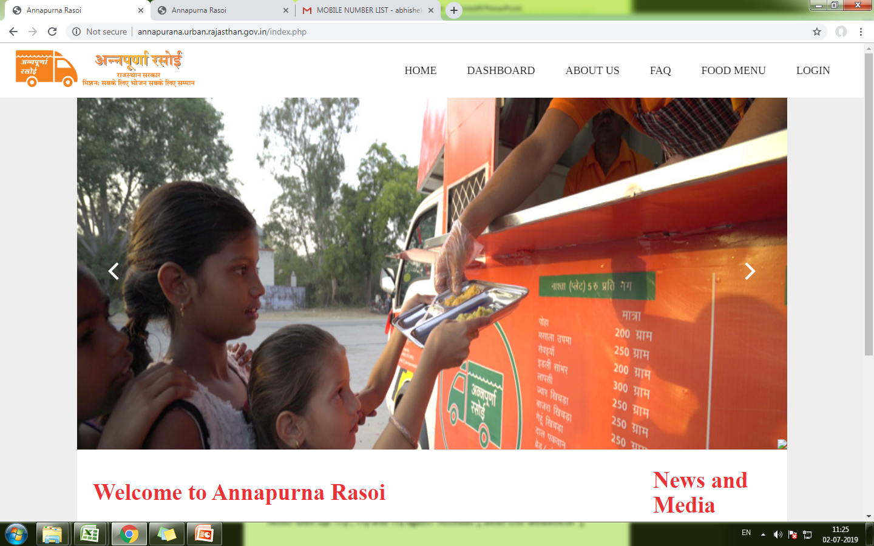

Slide 12
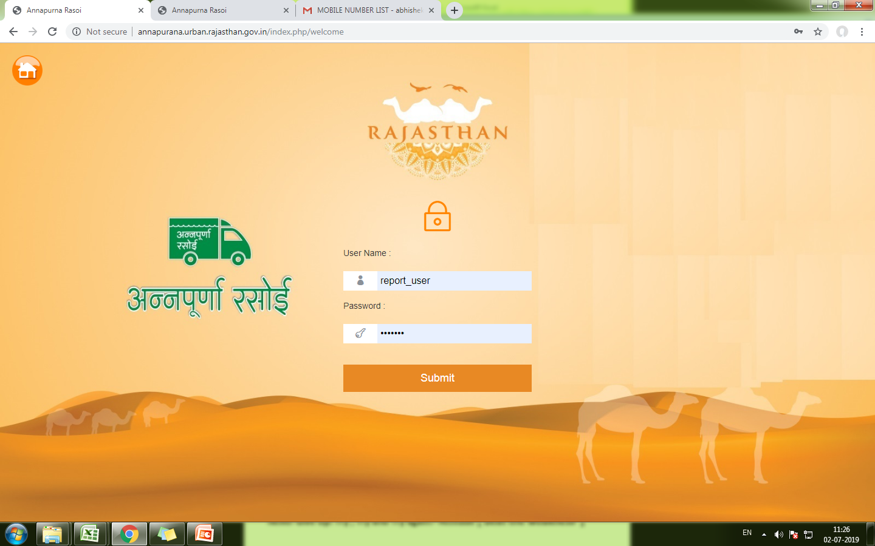

Slide 13
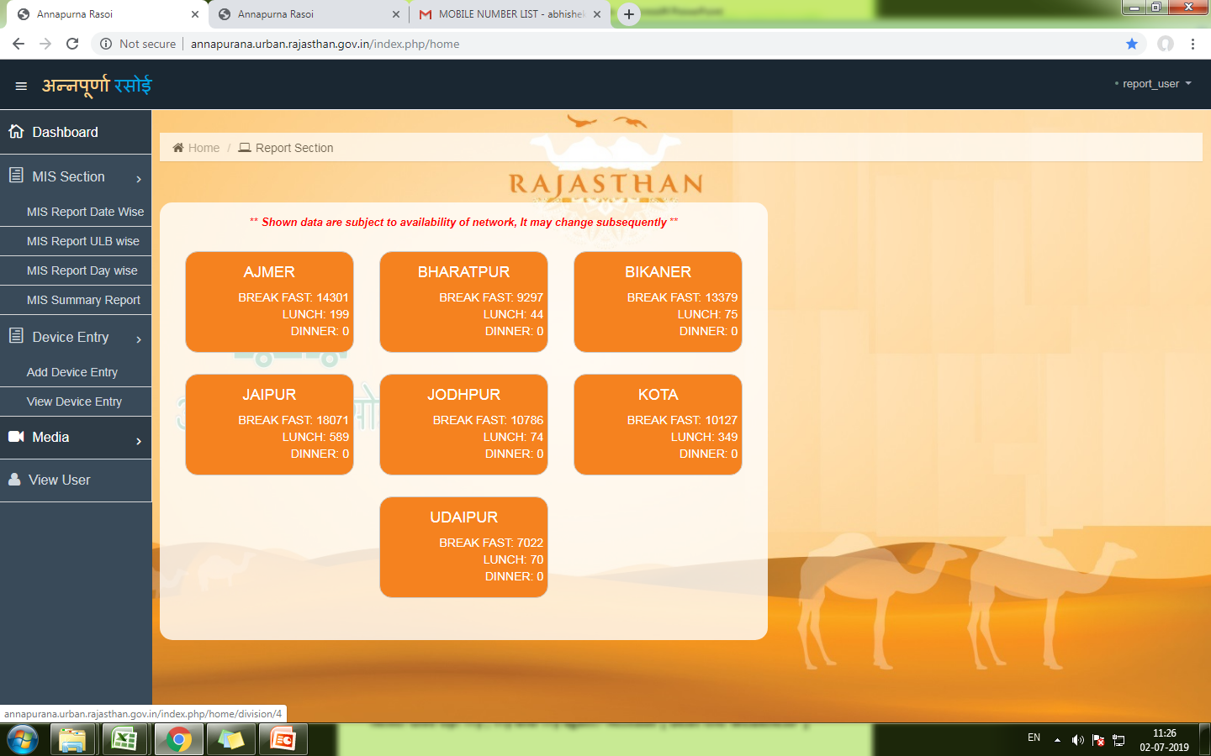

Slide 14
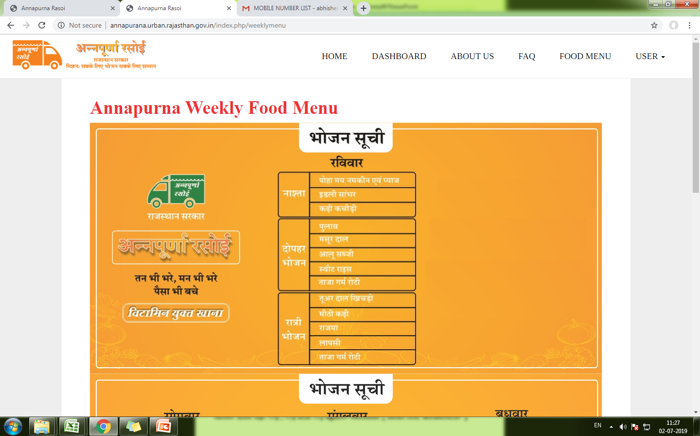

Slide 15
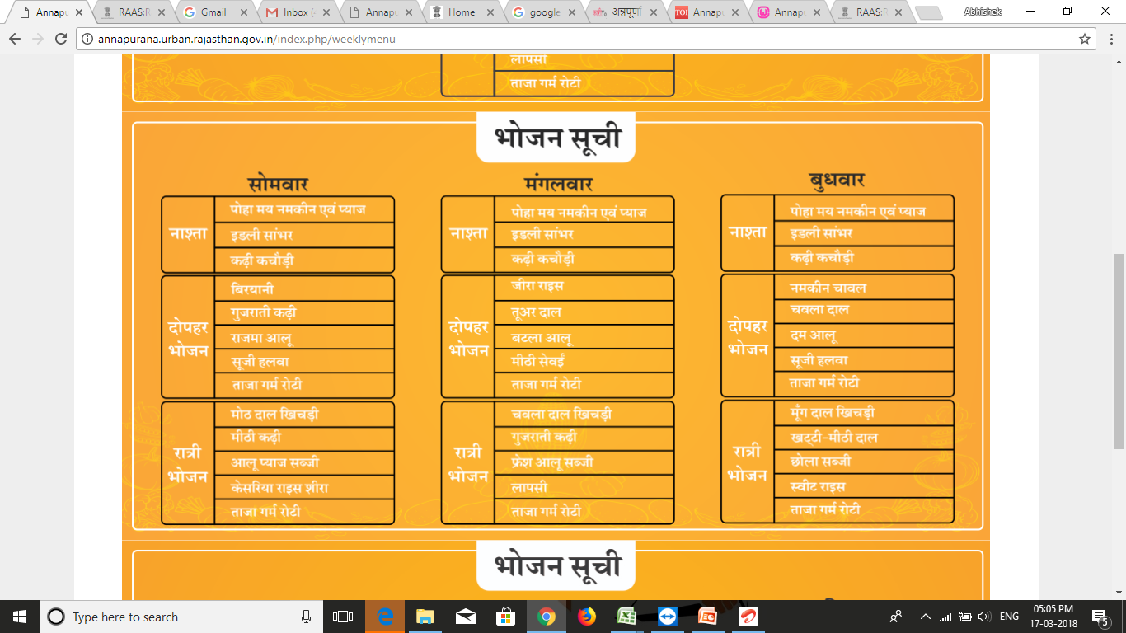
Notes:
Food Menu

Slide 16
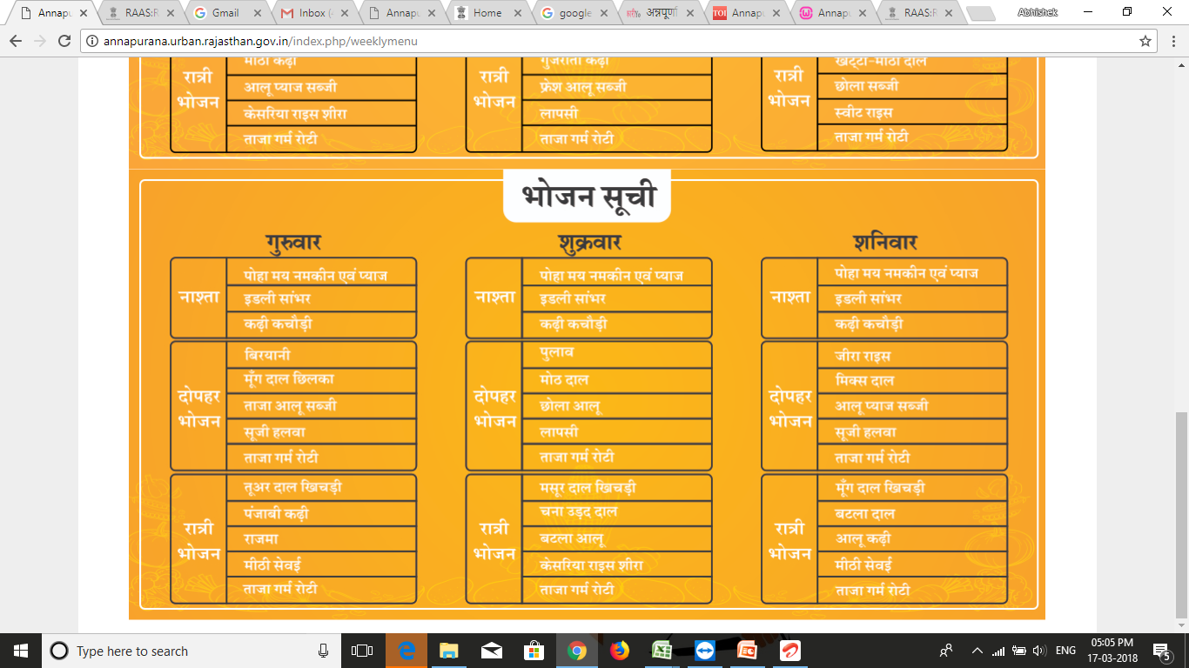
Notes:
Food Menu

Slide 17

POS Machine Data Fetching
POS Machine = When token cut by host it generate a request and pass it to server on network availability.
Server receive a request from user to add data
Data Addition
POS1
Server add request in its data base
POS 2
Σ
Server Add request
POS3
Network
Request

Slide 18

Working Process

Slide 19
The End
Than you for being here please ask you have any query and share your suggestion.

